Slide 1


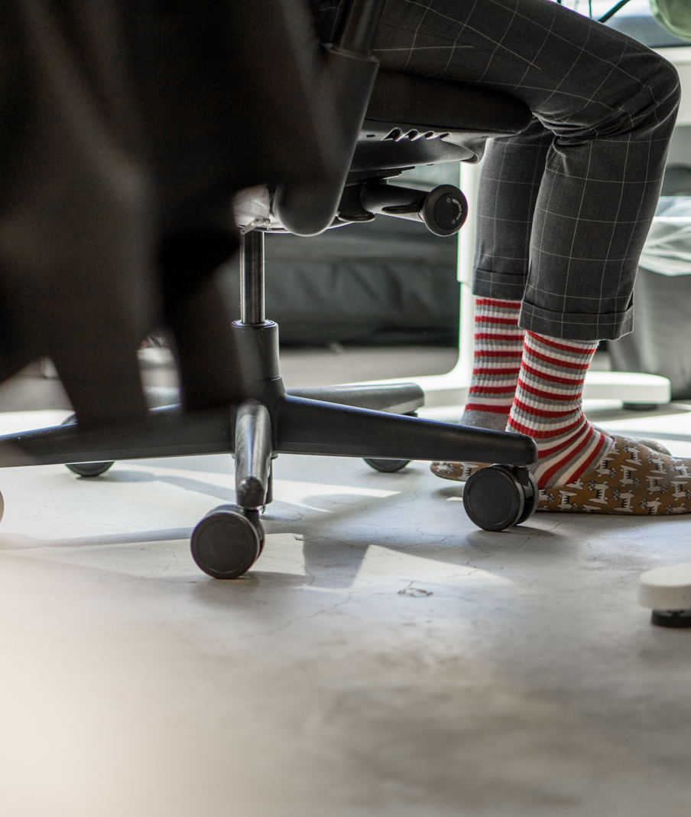
Alexa + Azure IoT Hub + Arduino
Codeaholics 2017 January Meetup

Slide 2
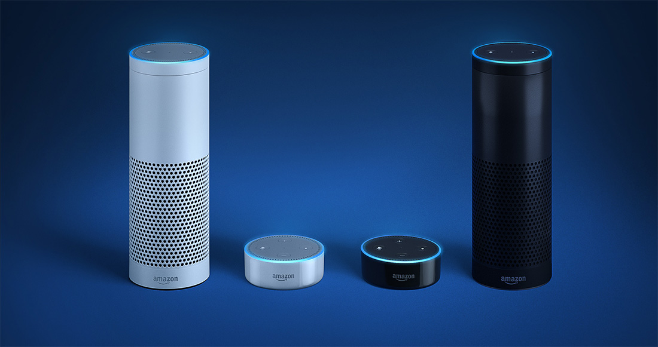

Slide 3
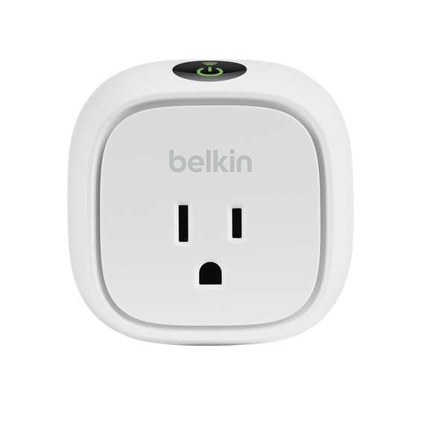
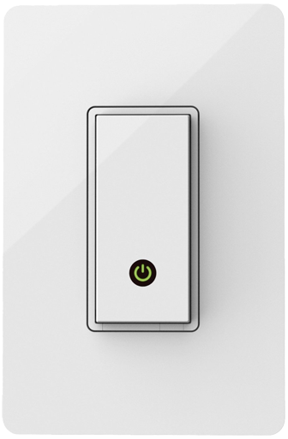
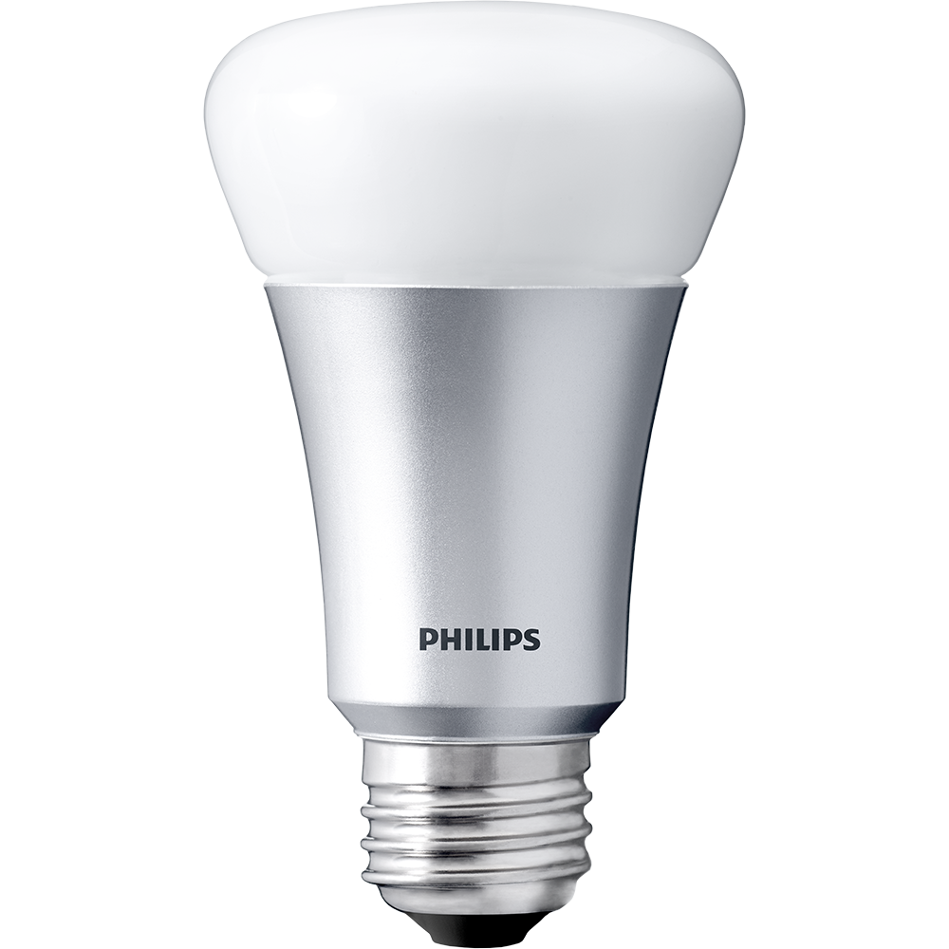
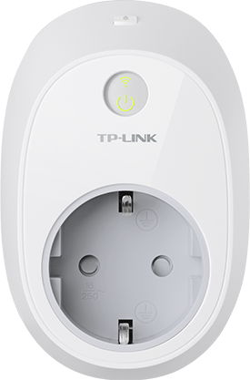
WEMO
Switch
WEMO
Light Switch
Philips Hue
Kasa

Slide 4
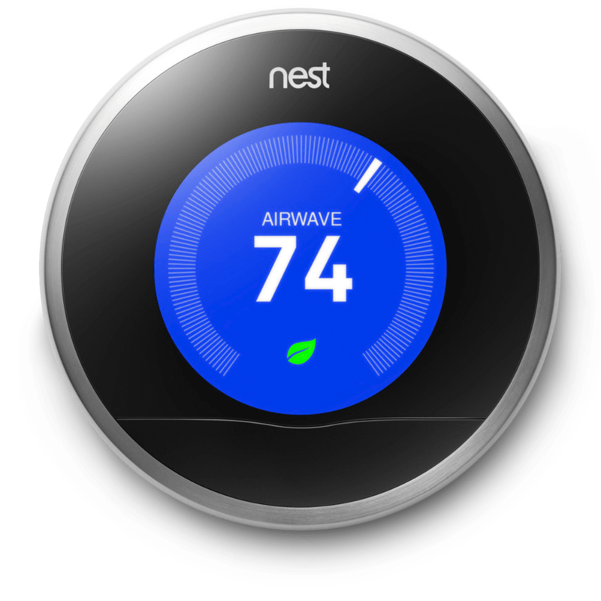
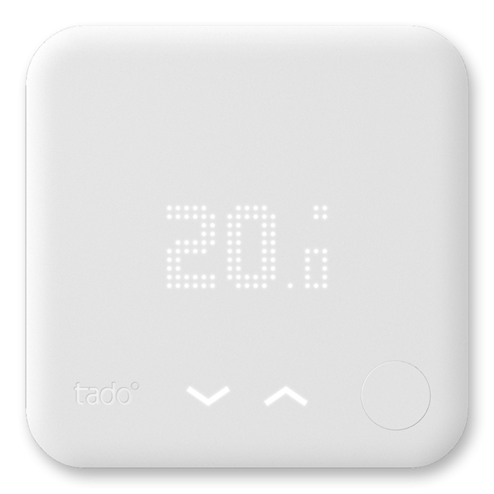
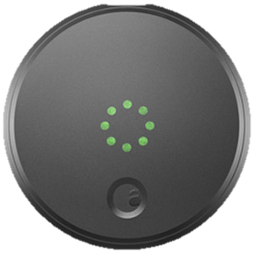
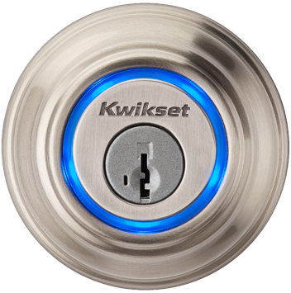
Nest
tado°
August

Slide 5
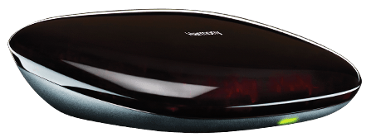

Logitech Harmony
"If This Then That"

Slide 6

B&O Beoplay A1

Slide 7
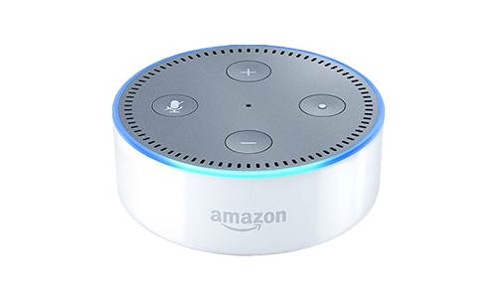
Amazon Echo Dot (2nd gen)

Slide 8
Amazon Echo Dot (2nd Gen)
PRICE
USD
$50.00
$40.00
Far-field voice recognition
Array of 7 microphones
Works 20+ feet away
Dual-band 802.11a/b/g/n
Speaker
Built-in
Bluetooth A2DP/AVRCP
3.5mm analog

Slide 9
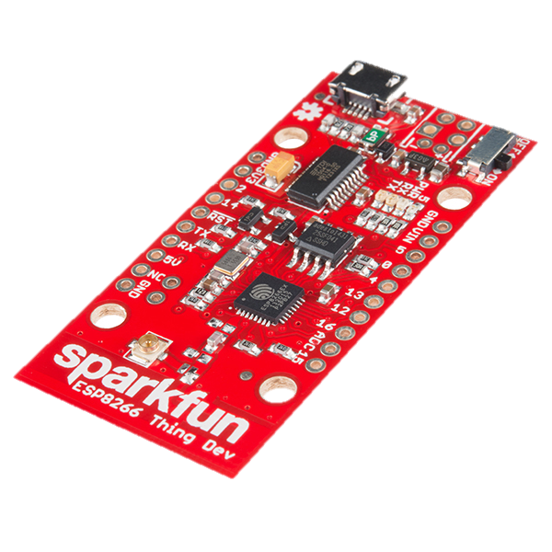


Sparkfun ESP8266 Thing
PRICE
USD
$15.95
802.11b/g/n with U.FL
USB-powered, 3.3V logic
Arduino-compatible
C language
Compatible with Firmata
Tiny – 6 cm × 3 cm
Cheap enough to replace Zigbee

Slide 10
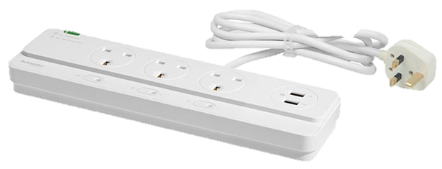
Schneider Powex
PRICE
HKD
$275.0
3- or 5-gang
Desktop remote
3.5mm plug
47KΩ when pressed
10MΩ when released
LED indicator (3.5V)
Will not shut off USB ports

Slide 11
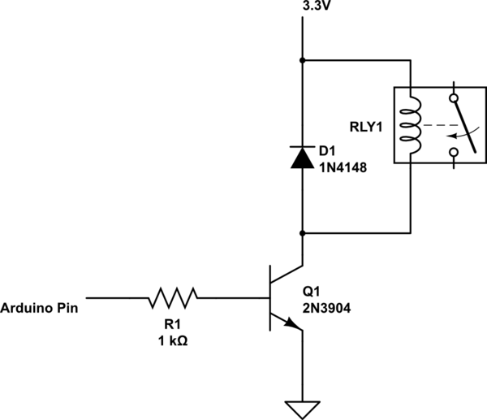
Control external circuit
PRICE
HKD
~$25
As a digital pushbutton
Physically isolated circuit
Protect from backfire
4 components
Relay – 3.3VDC or 5VDC
Diode – 1N4148
Transistor – 2N3904
Resistor – 1KΩ
All components from Apliu Street

Slide 12
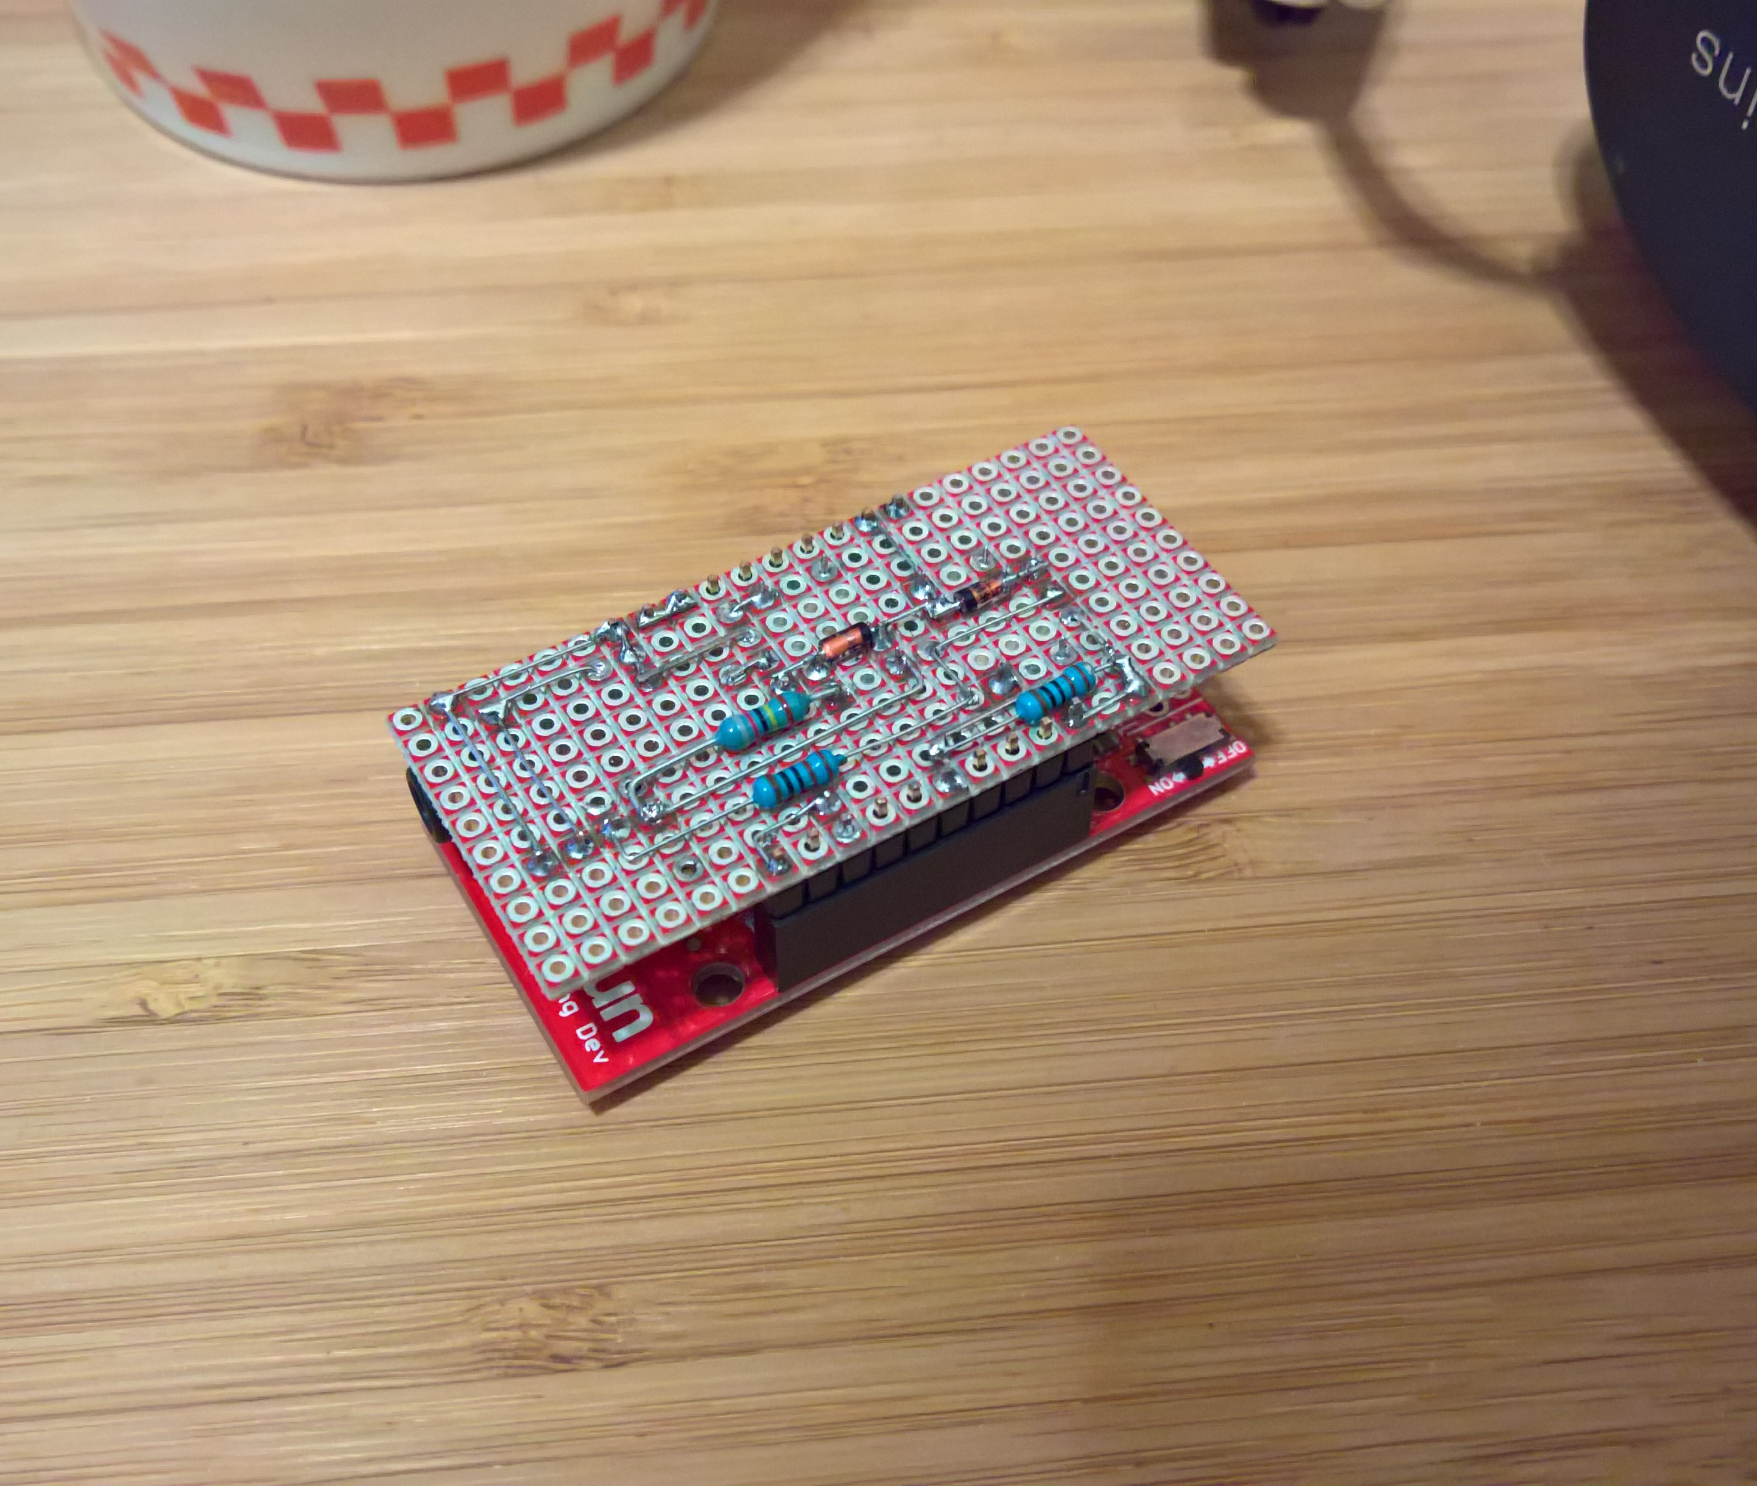
Control board
LABOR
2 hours
Shield on ESP8266
Snappable board
2 × relay circuit
3.5mm connector
1st relay – pushbutton
Open: 10MΩ
Close: 47KΩ
2nd relay – indicator
Open: Pull-down
Close: 3.3V

Slide 13
Alexa Skills Kit
Smart Home Skill API
Control appliances
Flash Briefing Skill API
Breakfast brief
Custom skill
Interactivity
"Alexa, turn on kitchen light."
"Alexa, set the bedroom to 24 degrees."
"Alexa, increase thermostat by 2 degrees."
"Alexa, set humidifier to 65 percent."
On/off, degree, percentage.
"Alexa, what's in the news?"
Audio
HTTPS to 256kbps MP3
Maximum 10 minutes
Text
RSS feed
Maximum 4500 characters
"Alexa, open Tide Pooler."
"Alexa, get high tide for Seattle from Tide Pooler."
"Alexa, ask Tide Pooler to get high tide for Seattle."
Skill API Comparison

Slide 14



Amazon Echo Dot
Alexa Voice Service
Alexa Skills Kit
AWS Lambda

Slide 15


Amazon Echo Dot
Alexa Voice Service
Alexa Skills Kit
AWS Lambda

Slide 16


Amazon Echo Dot
Alexa Voice Service
Alexa Skills Kit
AWS Lambda
Cloud service

Slide 17
Smart Home Skill
AWS Lambda
Cloud service

Slide 18
Smart Home Skill
AWS Lambda
Cloud service

Slide 19

Smart Home Skill
AWS Lambda
Azure IoT Hub

Slide 20
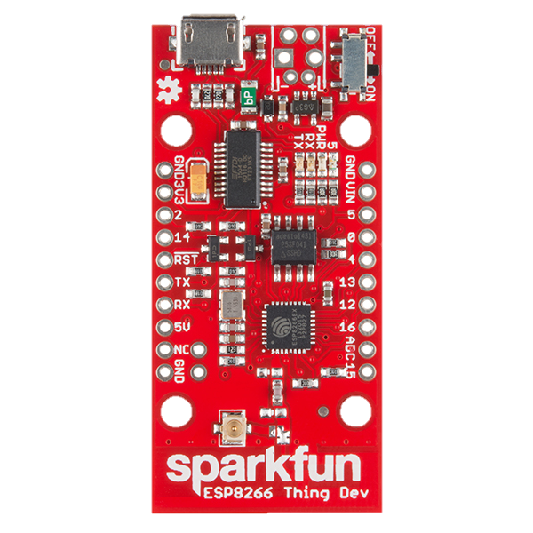
Smart Home Skill
AWS Lambda
Azure IoT Hub
Sparkfun ESP8266

Slide 21
Azure IoT Hub
Sparkfun ESP8266

Slide 22


Azure IoT Hub
Bridge
Sparkfun ESP8266

Slide 23
Firmata
over
TCP/IP
Amazon Echo Dot
Alexa Voice Service
Smart Home Skill
AWS Lambda
Azure IoT Hub
Bridge
Sparkfun ESP8266

Slide 26



Slide 28
Connectivity

Slide 29
Alexa Skills Kit
Alexa Voice Service

Slide 30
Alexa Skills Kit
Alexa Voice Service

Slide 31
Alexa Skills Kit
Alexa Voice Service

Slide 32




OAuth 2.0

Slide 33
OAuth 2.0

Slide 34
OAuth 2.0
Point of presence
Discovery and
control
Point of presence

Slide 35
Add skill to your Alexa

Slide 36
OAuth 2.0

Slide 37
OAuth 2.0
OAuth 2.0
Access token

Slide 38
Device discovery

Slide 39
Device discovery
{
event: {
header: {
namespace: 'Alexa.ConnectedHome.Discovery',
name: 'DiscoverAppliancesRequest',
payloadVersion: '2',
messageId: '1a2f8681-2b79-4471-9250-deadf00ddead'
},
payload: {
accessToken: 'AbC=='
}
}
}
OAuth2 against WEMO servers
Discovery command sent to WEMO servers

Slide 40
Device discovery
"discoveredAppliances": [
{
"actions": [
"turnOn",
"turnOff" ],
"additionalApplianceDetails": {},
"applianceId": "wemo1",
"friendlyDescription": "Lightings in kitchen",
"friendlyName": "Kitchen light",
"isReachable": true,
"manufacturerName": "Belkin",
"modelName": "WEMO",
"version": "1.0"
},
{ … }
]
All registered devices on WEMO cloud are reported
Discovery can be done online or offline

Slide 41
Device control

Slide 42
OAuth 2.0

Slide 43
OAuth 2.0
Control
Control

Slide 44
Device control
{
"event": {
"header": {
"namespace": "Alexa.ConnectedHome.Control",
"name": "TurnOnRequest",
"payloadVersion": "2",
"messageId": "770f765e-6fa2-44a2-a01e-deadf00ddead"
},
"payload": {
"accessToken": "AbC==",
"appliance": {
"applianceId": "wemo1",
"additionalApplianceDetails": {}
}
}
}
}
Turn on or off a device
Control by degree or percentage
Reply with TurnOnConfirmation or TargetOfflineError

Slide 45
Azure IoT Hub

Slide 46
OAuth 2.0

Slide 47
OAuth 2.0

Slide 48
OAuth 2.0

Slide 49
OAuth 2.0

Slide 50
OAuth 2.0
Invoke device method thru MQTT

Slide 51
Device Method
client.invokeDeviceMethod(
'powerStrip1',
{
methodName : 'turnOn',
payload : {},
responseTimeoutInSeconds: 10
},
(err, result) => {
if (!err && result.status === 200) {
...
}
}
);
Request-response model
Can traverse firewall

Slide 52
OAuth 2.0

Slide 53
OAuth 2.0
Send Firmata message

Slide 54
Firmata
const relay = new Pin(15);
const indicator = new Pin(4);
indicator.read((err, value) => {
if (!value) {
relay.high();
setTimeout(() => relay.low(), 500);
}
});
Johnny-five is an implementation of Firmata on Node.js
If pin 4 is low, the power strip is off
If power strip is off, turn it on by flipping pin 15

Slide 55
Takeaway

Slide 56
Amazon Echo Dot (2nd Gen)
Far-field microphone array is not noise-proof
Voice recognition is done on the cloud
Group multiple appliances

Slide 57
Smart Home API
Must talk to AWS Lambda before your cloud service
Limited utterances
Lambda is Node 4.3 and difficult to debug

Slide 58
Azure IoT Hub
Sensor events, device methods, or file upload
Standard protocol means lots of libraries
Can traverse firewall

Slide 59
Local bridge
Optional but recommended
Firmata makes coding Arduino easy
Can run on Raspberry Pi
Very flaky disconnect detection and reconnection logic

Slide 60
Sparkfun ESP8266 Thing
Inexpensive Wi-Fi-enabled IoT
Very limited pins (go ESP32)
Firmata is a bit slow to boot
No heartbeat and/or hardware watchdog

Slide 61
Schneider Powex
Expensive but luxury
Ready to be hacked
When indicator is off, it still pulse

Slide 62

https://bit.ly/codeaholicsiot

Slide 64


Slide 65

Coming this April 22

Slide 67
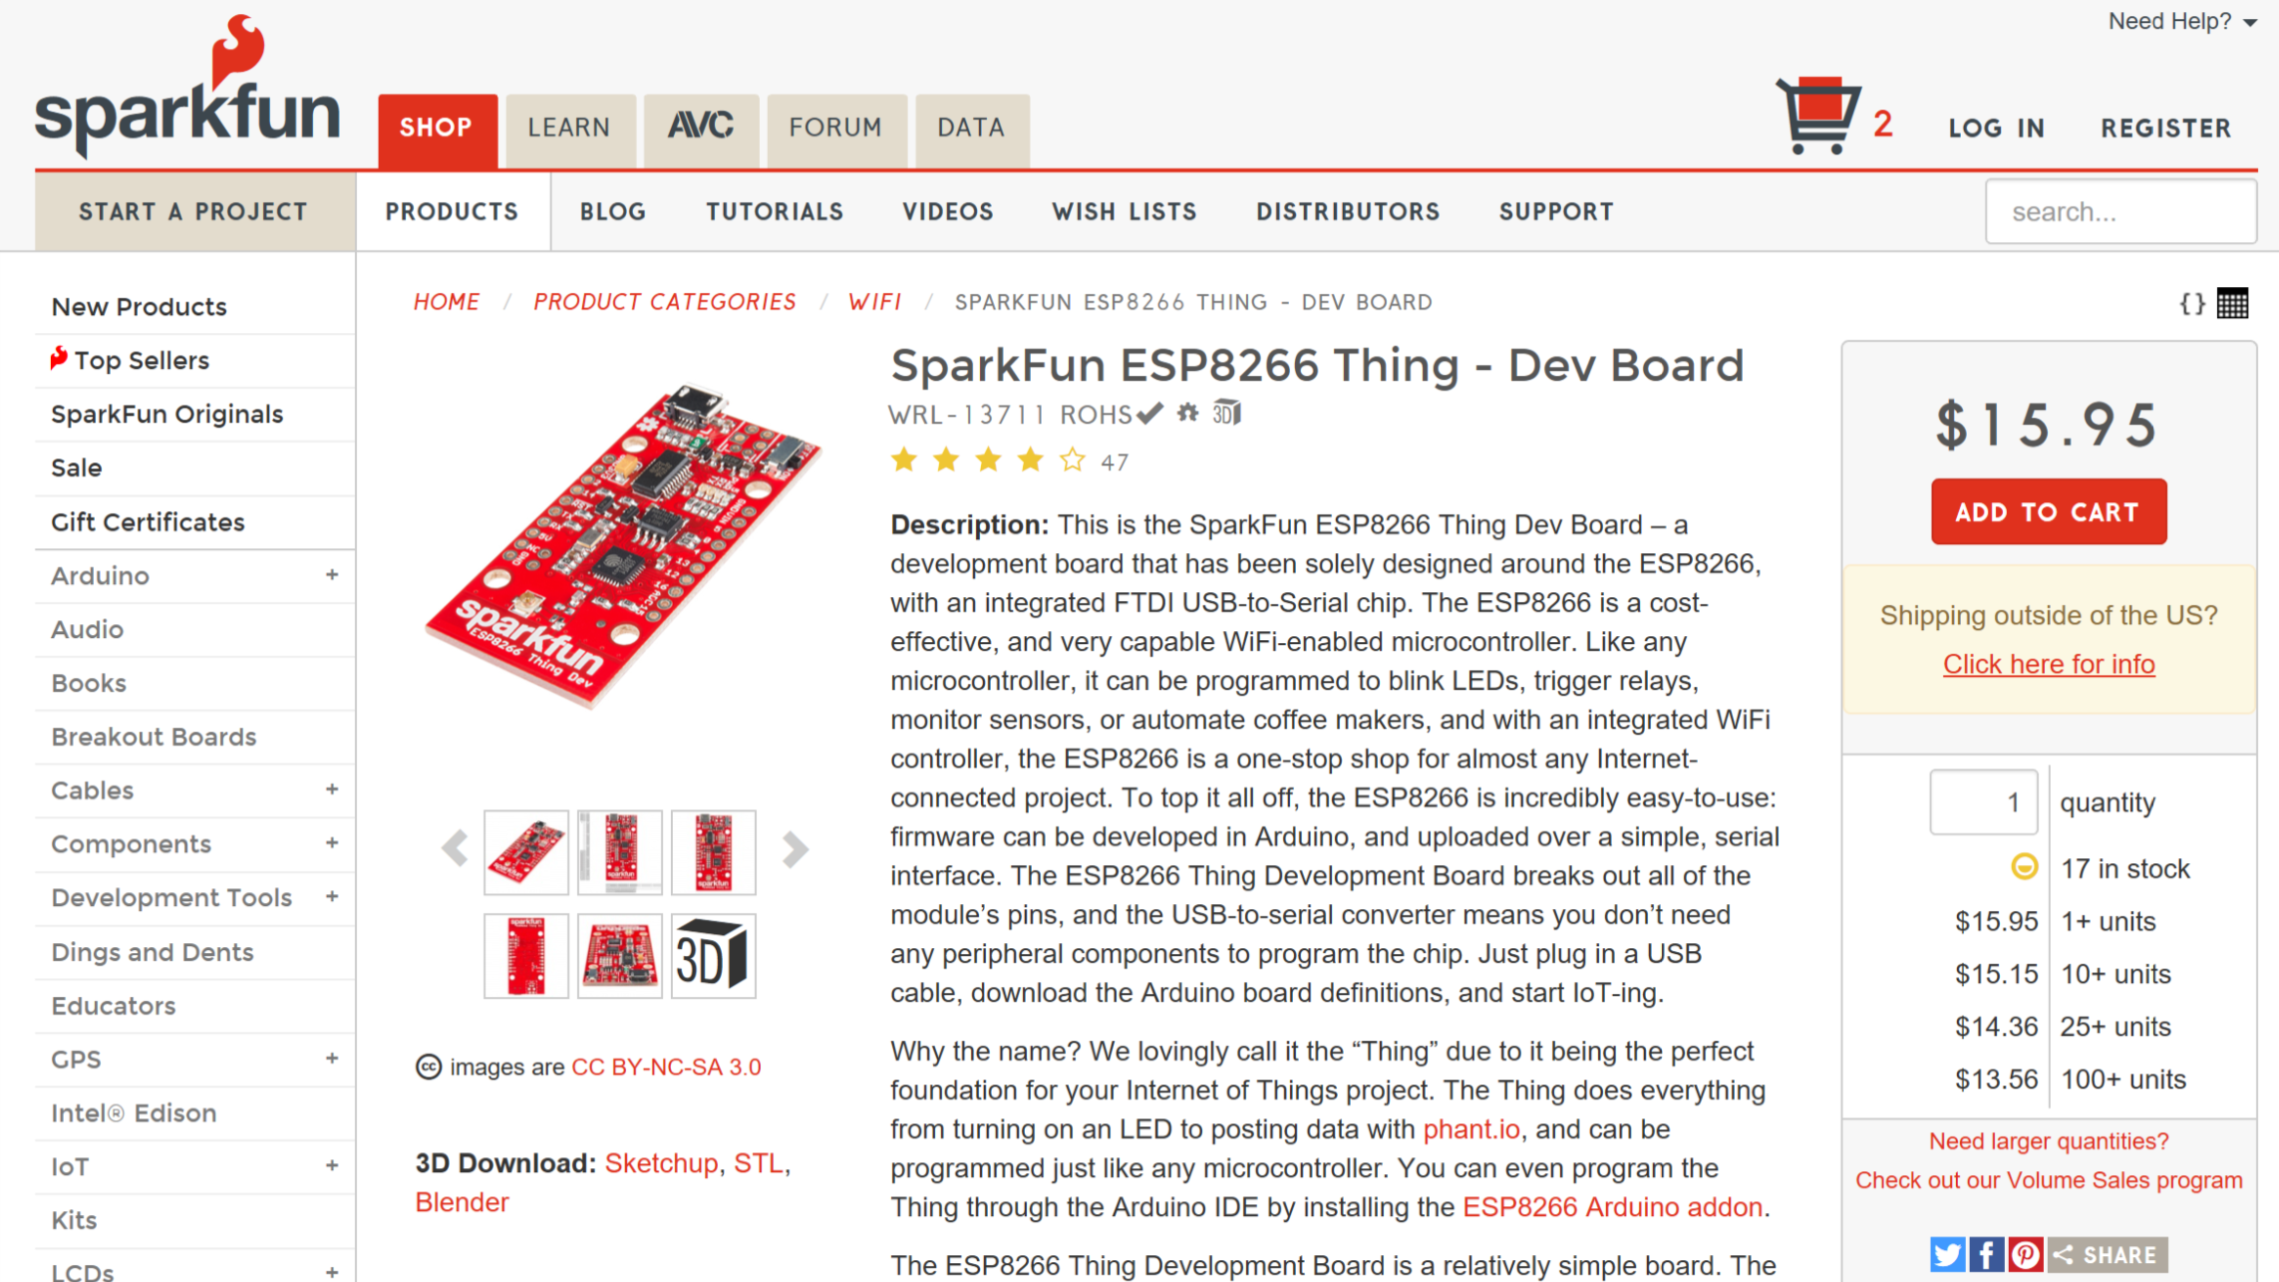

Slide 68
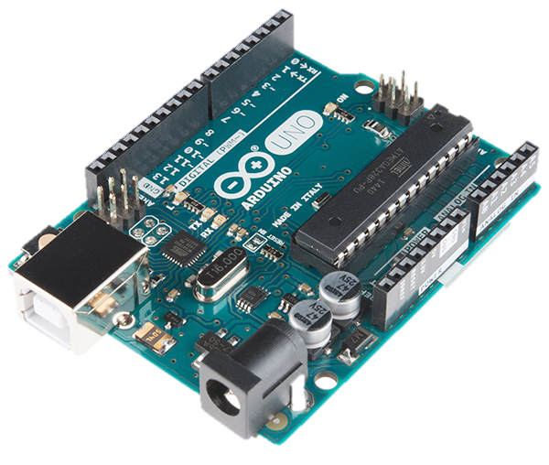
Arduino Uno
Open source board design
Serial port
Many clones
Accessories are called shields
Ethernet
GPS
Bluetooth
Wi-Fi
Relay

Slide 69
